Slide 1
Soldier ASSISTANCE VEHICLE
Technical Seminar - I
R.Natheeshkumar(161ec201)

Slide 2
INTRODUCTION:
In Real time battlefields the army soldiers need to carry their needs (Ammunition ,First aid ,etc.) for a long distance which requires additional man power and soldiers. In order to overcome this situation we have designed an unmanned autonomous vehicle to carry their needs. The vehicle follows the soldier by detecting the movements of soldier. An IR sensor and Ultrasonic sensor is used to detect the movement of soldier. Based on the observations from the sensors the vehicle is driven by using servo motor and motor driver. Rocker bogie mechanism is used to drive the vehicle in all terrains. A GPS module is used to track the location of the vehicle by sending the data to control room through the GSM module. A solar powered battery is used to power the vehicle. In addition to these the movement of vehicle can also be monitored by using IP webcam app.

Slide 3
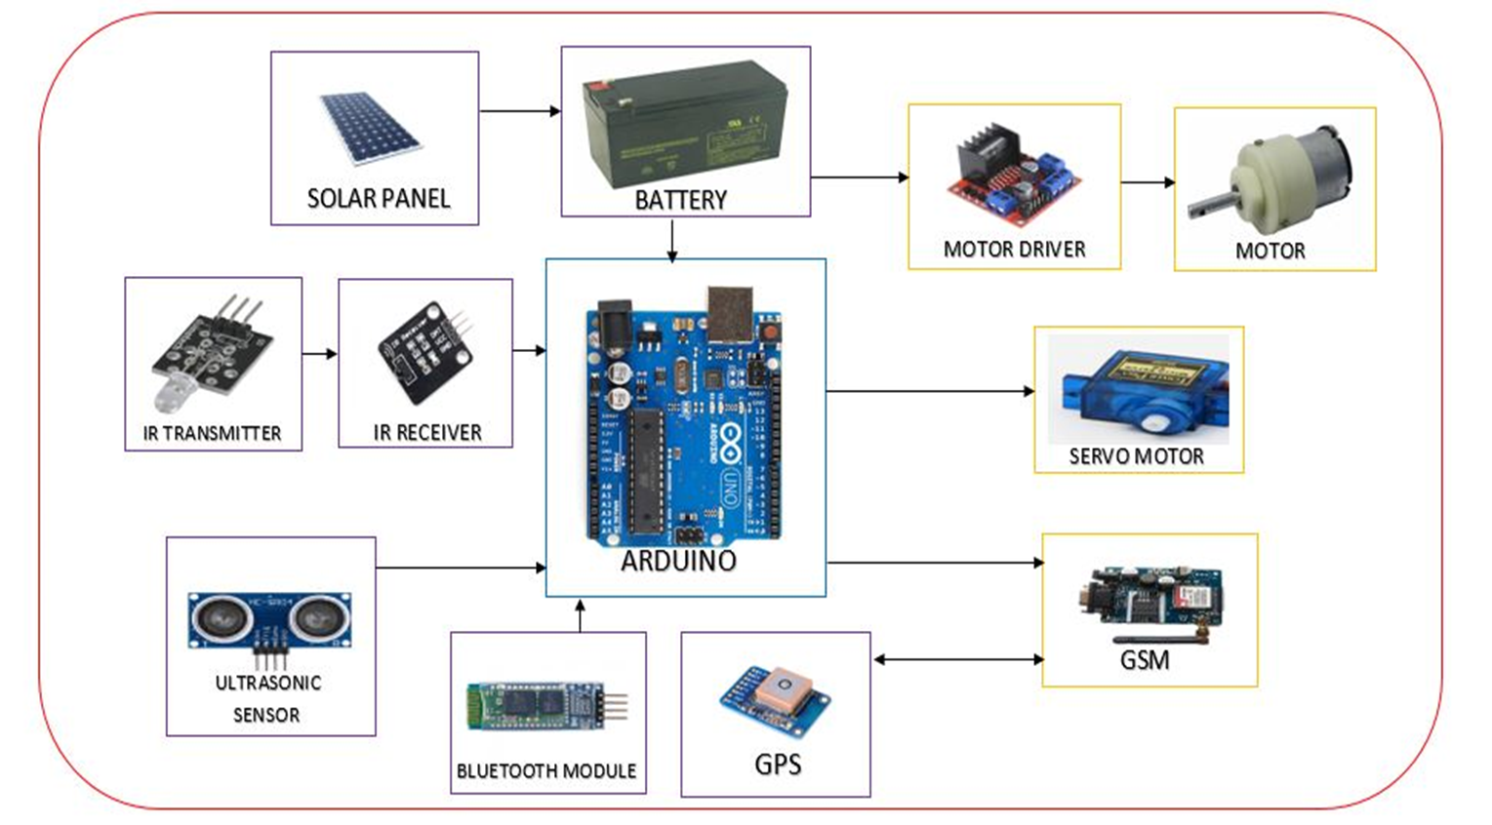
BLOCK DIAGRAM:

Slide 4
Vehicle following Algorithm:
START
FRONT SENSOR START SENSING
If(FS<180||(RS>=10&&RS<=100))
If(FS<180||((LS>=10&&LS<=100))
If(FS>=15&&FS<=180)
TURN LEFT
TURN RIGHT
MOVE FRONT
STOP

Slide 5
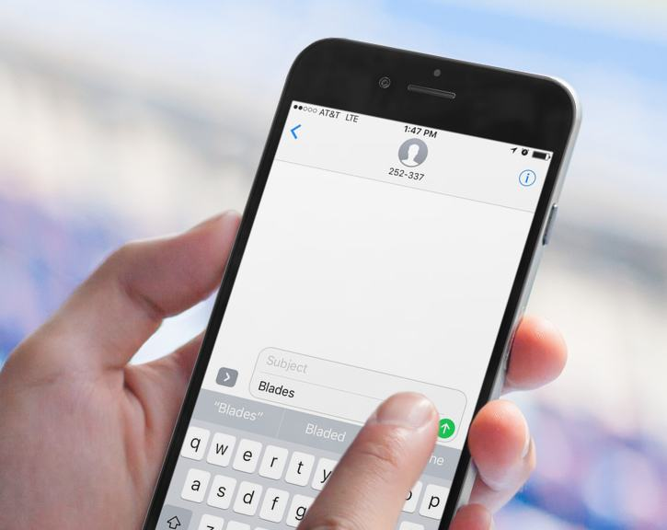
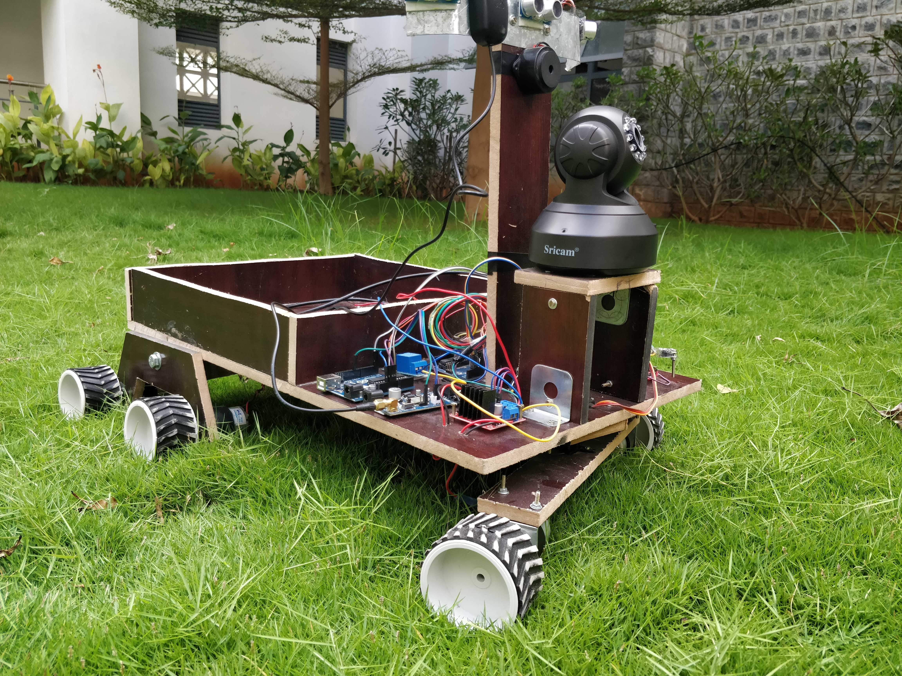
location TRACKING:
MSG AS “TRACK”
SOLDIER ASSISTANT VECHICLE:
YOUR BOT CURRENT LOCATION IS:
LATITUDE:1123.987
LONGITUDE:0717.987
MESSAGE SENT BY SOLDIER BOT
REPLIED MSG

Slide 6


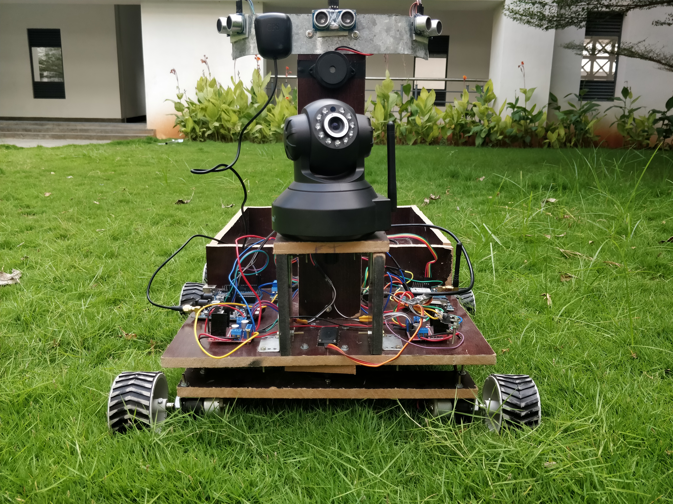

IP BASED CAMERA LIVE STREAMING:
WEB ADDRESS

Slide 7
CONCLUSION:
The proposed prototype is designed to overcome these drawbacks by making use of technologically more improved and efficient techniques. The Soldier Assistance Vehicle (SAV) is an unmanned autonomous robot which is used to follow the soldier to battlefield by carrying their needs like ammunition, food, medicines, etc. The vehicle is also capable of working in rough terrains like mountains, slopes, etc. The Soldier Assistance Vehicle (SAV) follows the soldier by detecting the movements of the soldier. The main controller of the vehicle is the Arduino UNO which is used to drive the vehicle based on the values from the ultrasonic sensor. The vehicle can be tracked with the help of the GPS and GSM module interfaced in the vehicle.

Slide 8
Thank you

